Slide 1
ENPOWERING ACADEMIC LEARNING
By
ANUBHAV SHARMA
(CUHP21MCA08)
ABHISHEK KUMAR
(CUHP21MCA03)

Slide 2
Introduction
In this presentation, we present Study Point a student management system that provides question papers and study material to students. To make educational resources more available to students by providing study materials and previous year question paper.

Slide 3
Purposed System
Our project is made for provide study material or previous question papers for students.
Benefits-
1.This website enhance the learning experience
of students.
2. StudyPoint offers a range of functionalities, providing students with high-quality Study resources
3. Students may quickly download test questions and access suggested notes, saving time and effort.

Slide 4
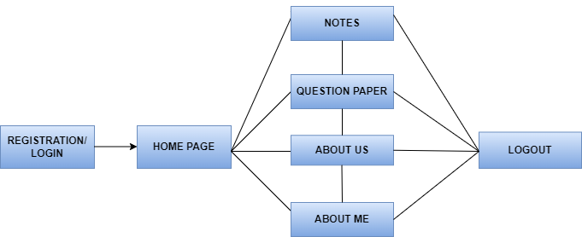
Flow Chart
Empowering Academic Learning

Slide 5
System Requirements
Operating System - Windows 10
Front End - HTML, CSS, Bootstrap
Backend - PHP
Database - MySQL
Web Server - Apache

Slide 6
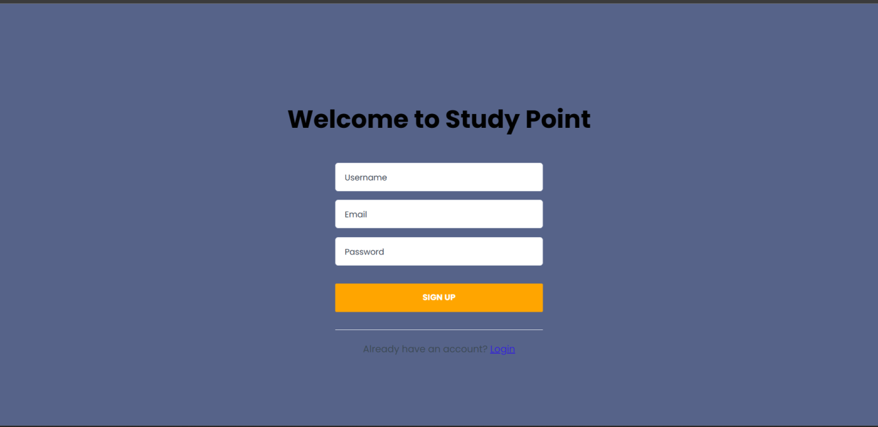
Snapshot of Project
Registration Page:

Slide 7
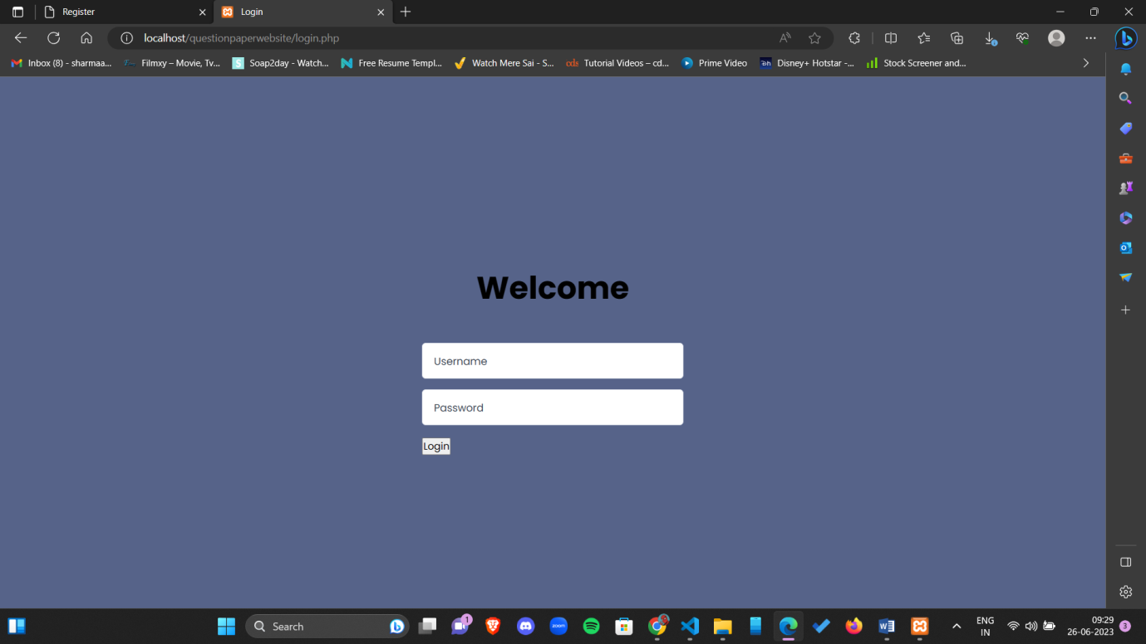
Login Page

Slide 8
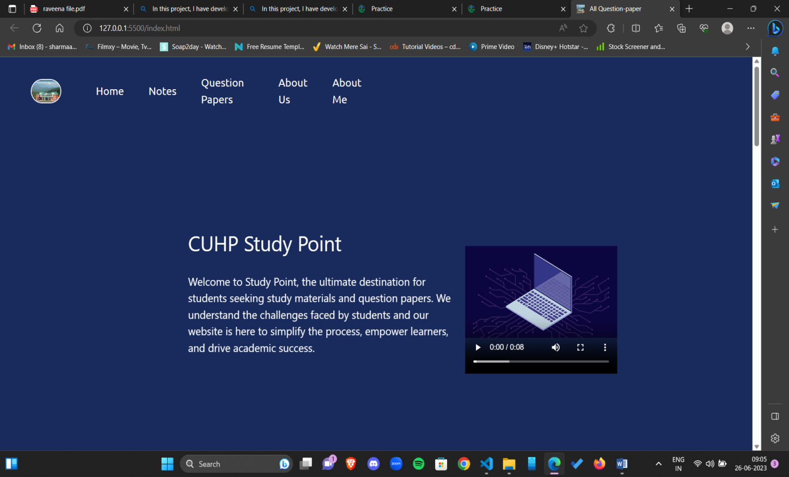
Home Page

Slide 9
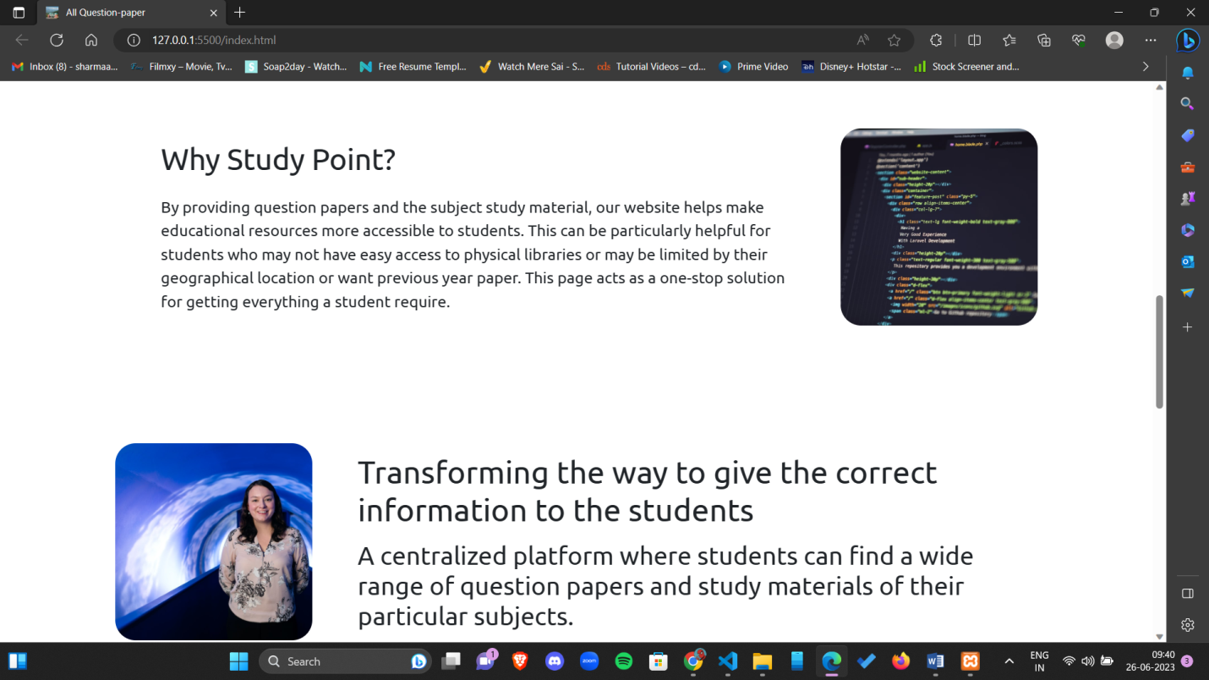
Home Page

Slide 10
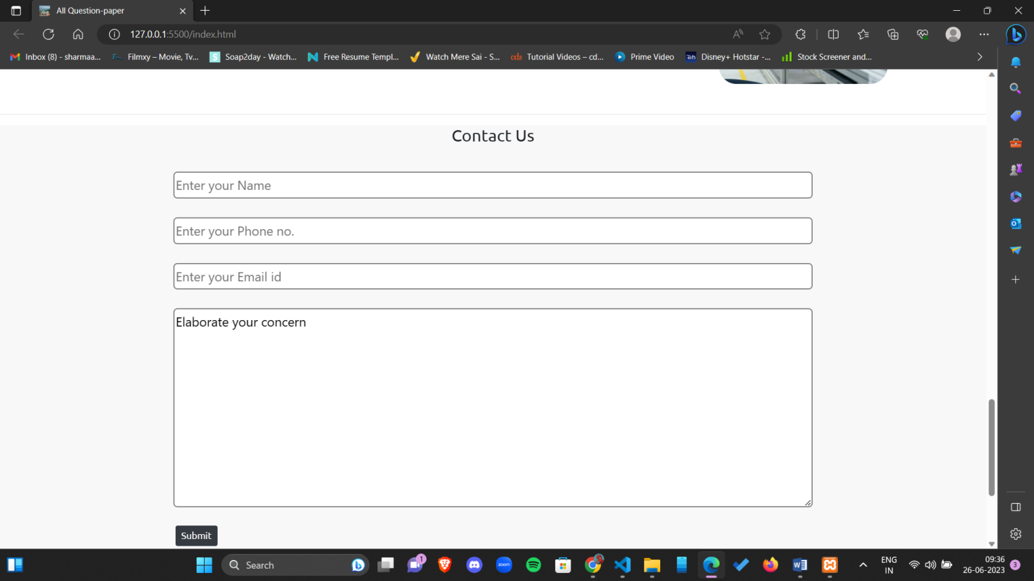
Contact Form

Slide 11
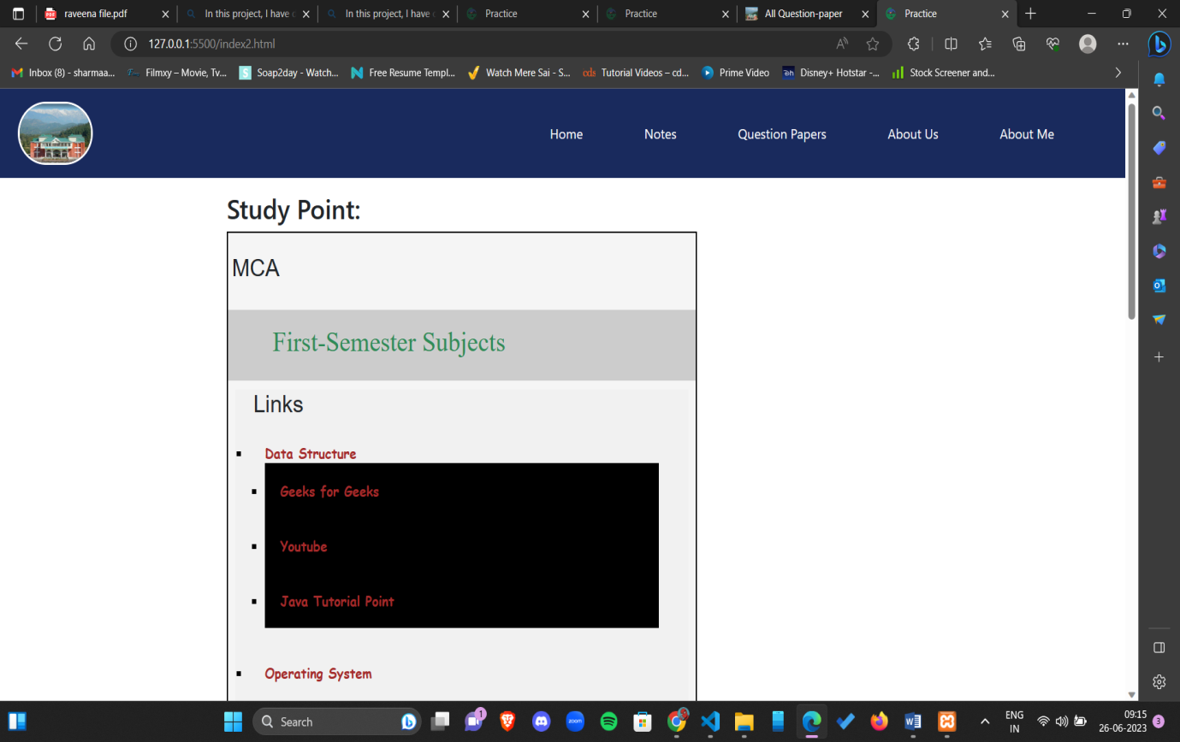
Study Material

Slide 12
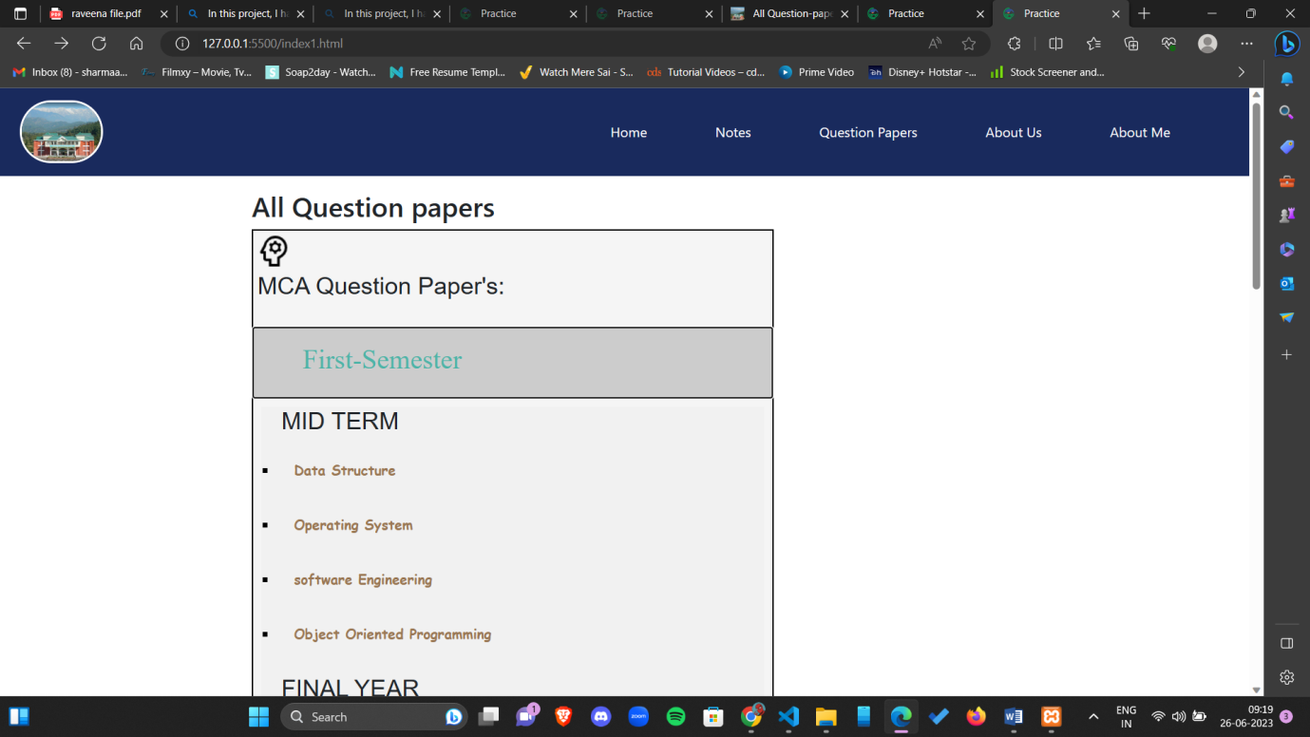
Question Paper

Slide 13
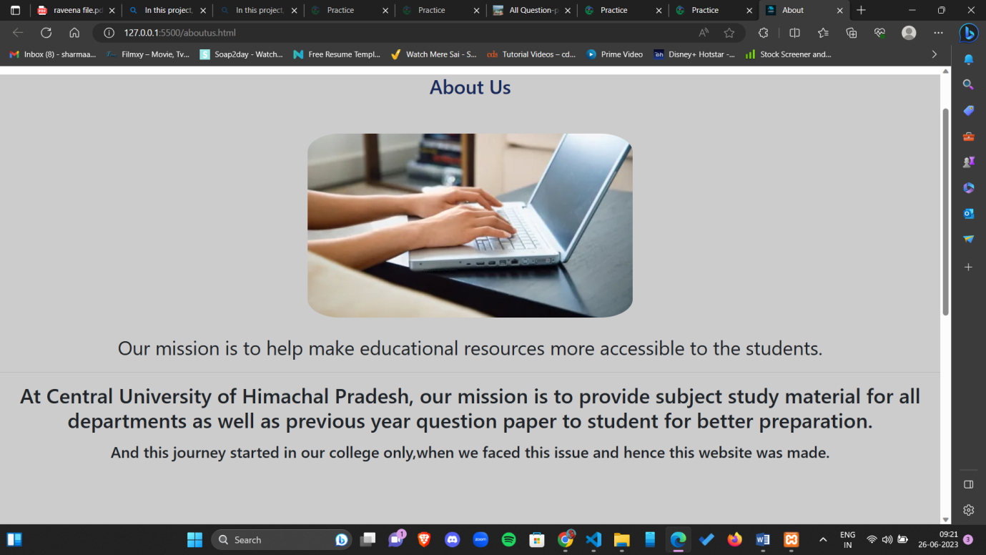
About Us

Slide 14
Conclusion
This web application helps in providing study material and previous year question papers to make educational resources more available to students. This website aims to enhance the learning experience and academic performance of users. The website has successfully achieved its objectives of providing a user-friendly platform students and administrators. StudyPoint offers a range of functionalities, providing students with high-quality Study resources and question papers enabling students to enhance their knowledge and skills.

